Slide 1

GhostMinion: A Strictness-Ordered Cache System for Spectre Mitigation^{[1]}
Sumon Nath
sumon@cse.iitb.ac.in
[1] Ainsworth, Sam. "GhostMinion: A strictness-ordered cache system for Spectre mitigation." In MICRO-54: 54th Annual IEEE/ACM International Symposium on Microarchitecture, pp. 592-606. 2021.

Slide 2
Recap- Spectre
2
1
Attacker
Victim
Set 0
Set 1
Secret
Primes
3
Shared[Secret]
Cache
Problem: Access to speculative data across domain boundaries

Slide 3

Recap- MuonTrap
DRAM
Stores all speculative data
Wiped on context switch
Non-inclusive/non-exclusive
Instruction cache, TLBs
LLC
L2
L1D
Filter cache
L0
Does this work always?
CPU

Slide 4
Attack scenario
*execution: out-of-order
… = *X;
… = *Y;
non-spec instrs;
if(i < N) { //mispredict
secret = A[i];
k = B[secret * 64];
spec dependent instrs(k); }
0 or 1
&B[0] cached
&B[64] not cached

Slide 5
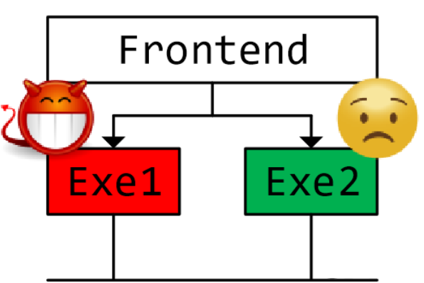
Execution unit contention
non-spec instrs;
if(i < N) { //mispredict
secret = A[i];
k = B[secret * 64];
spec dependent instrs(k); }
CDB

Slide 6
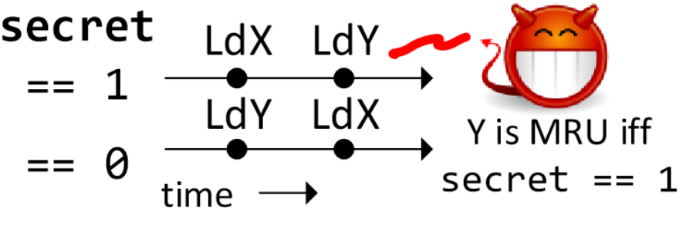
Attack scenario
non-spec instrs;
if(i < N) { //mispredict
secret = A[i];
k = B[secret * 64];
spec dependent instrs(k); }
Speculative Interference^{[2]}
[1] Behnia, Mohammad, Prateek Sahu, Riccardo Paccagnella, Jiyong Yu, Zirui Neil Zhao, Xiang Zou, Thomas Unterluggauer et al. "Speculative interference attacks: Breaking invisible speculation schemes." In Proceedings of the 26th ACM International Conference on Architectural Support for Programming Languages and Operating Systems, pp. 1046-1060. 2021.

Slide 7

Does MuonTrap work?
non-spec instrs;
if(i < N) { //mispredict
secret = A[i];
k = B[secret * 64];
spec dependent instrs(k); }
Does not take care of backwards-in-time channels
No!

Slide 8
Till now…
Spectre
MuonTrap
Speculative Interference
Why MuonTrap does not work?
Next: GhostMinion

Slide 9
What can be done?
non-spec instrs;
if(i < N) { //mispredict
secret = A[i];
k = B[secret * 64];
spec dependent instrs(k); }
We need to restrict backward-in-time channels
How?

Slide 10
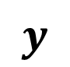
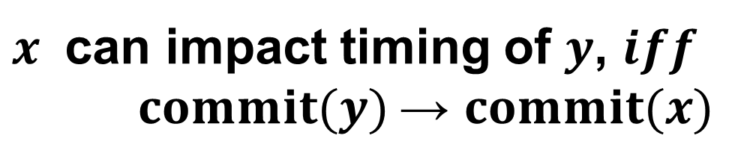
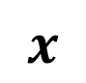
Strictness ordering
$x$ can impact timing of $y$, $iff$
$commit(y)$→ $commit(x)$
$$y$$
non-spec instrs;
if(i < N) {
secret = A[i];
k = B[secret * 64];
spec dependent instrs(k); }
commits
doesn’t
commit
$$x$$

Slide 11
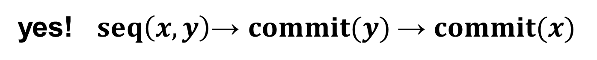
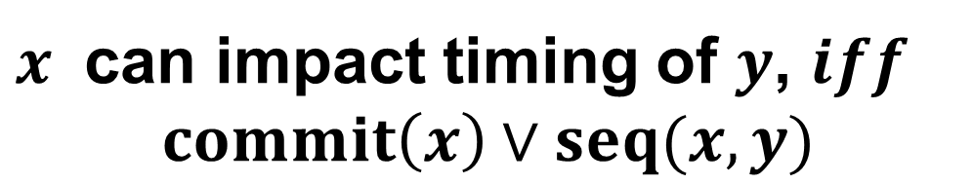
Temporal ordering
*strictness ordering hard to implement
$x$ can impact timing of $y$, $iff$
$commit\left(x\right)∨seq(x, y)$
Does it ensure strictness ordering?
yes! $seq\left(x, y\right)\text{→} commit(y) \text{→ }commit(x)$

Slide 12
Implementation
GhostMinion - cache system
Techniques:
TimeGuarding
Free-slotting
LeapFrogging
*Applied to other microarchitecture structures

Slide 13
GhostMinion
Same as MuonTrap
Accessed in parallel to L1D
DRAM
LLC
L2
L1D
GM
CPU

Slide 14
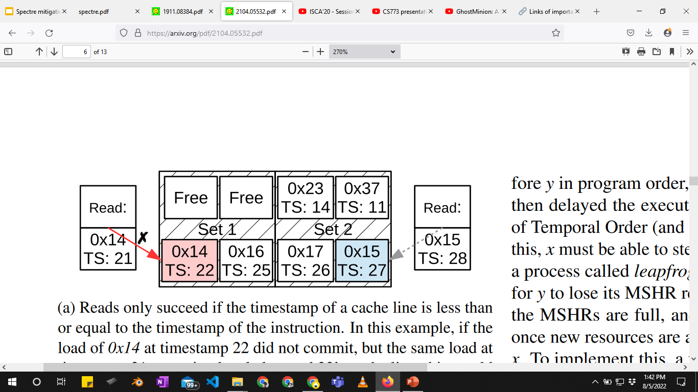
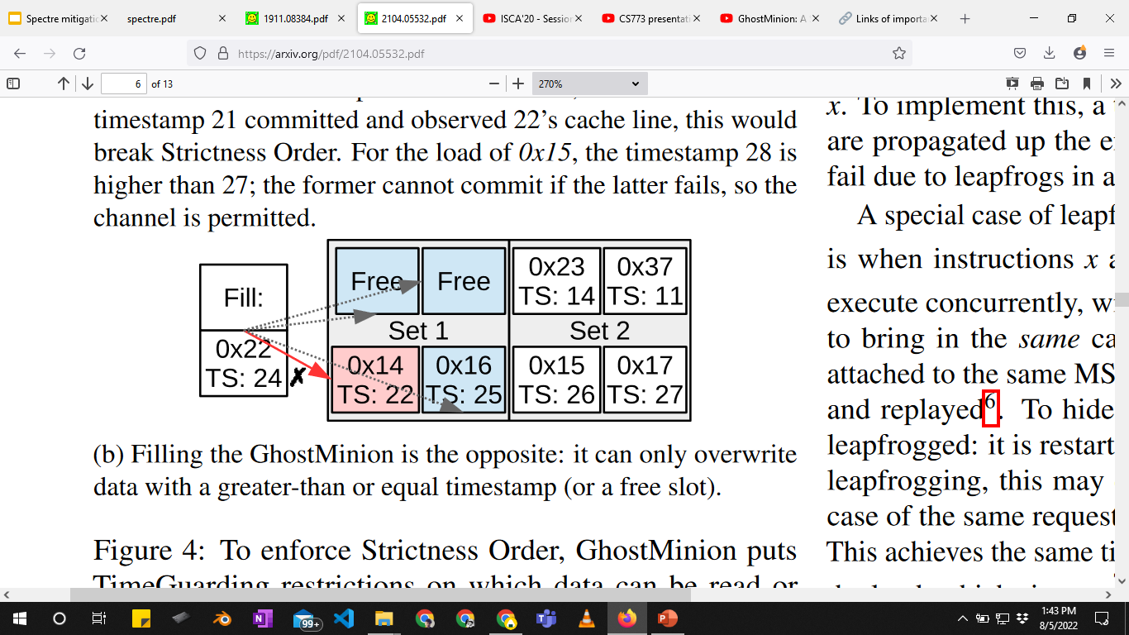
TimeGuarding
Ensures temporal ordering
Read
Fill

Slide 15
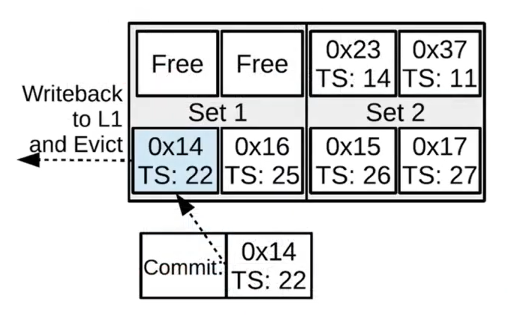
Free-slotting
Avoids resource starvation

Slide 16
LeapFrogging
MSHR:
stores miss status
enables parallel misses
Non-inclusive/
non-exclusive cache
DRAM
MSHR
LLC
MSHR
L2
MSHR
L1D
GM
CPU

Slide 17
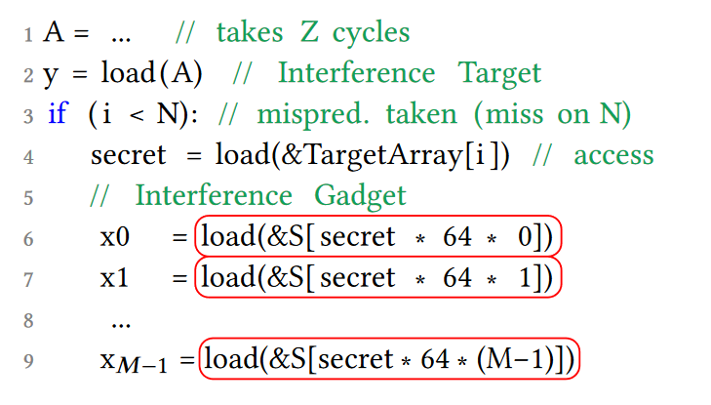
Attack scenario

Slide 18
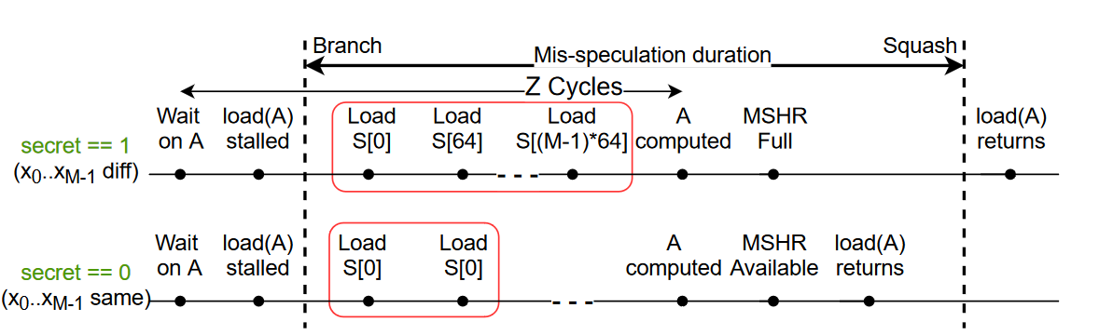
Attack scenario
violates strictness ordering

Slide 19
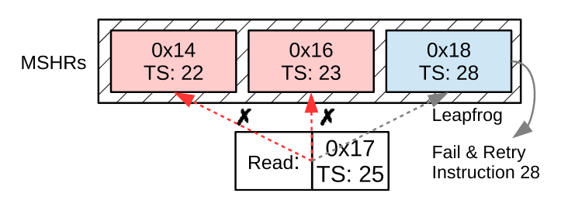
LeapFrogging
Older instruction can kick out MSHR entry of newer instruction

Slide 20
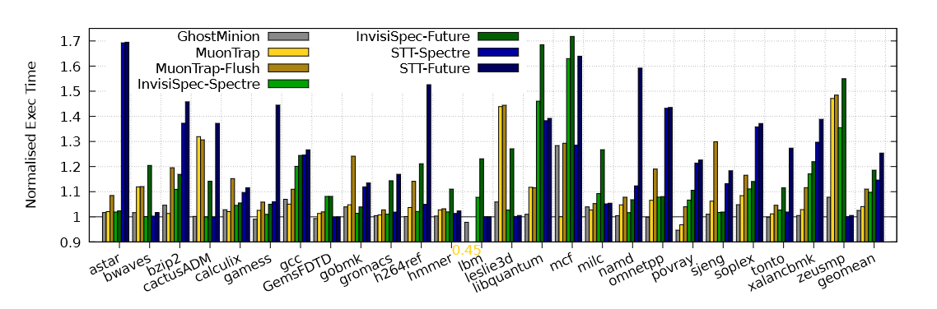
Performance evaluation: SPEC 2006
GhostMinion 2.5% slowdown compared to 4% slowdown for MuonTrap

Slide 21
Conclusion
MuonTrap was the first to solve Spectre with comparatively low performance overhead.
GhostMinion proposes a precise framework to avoid Spectre and its different variants.

Slide 22
Thank You!

Slide 23
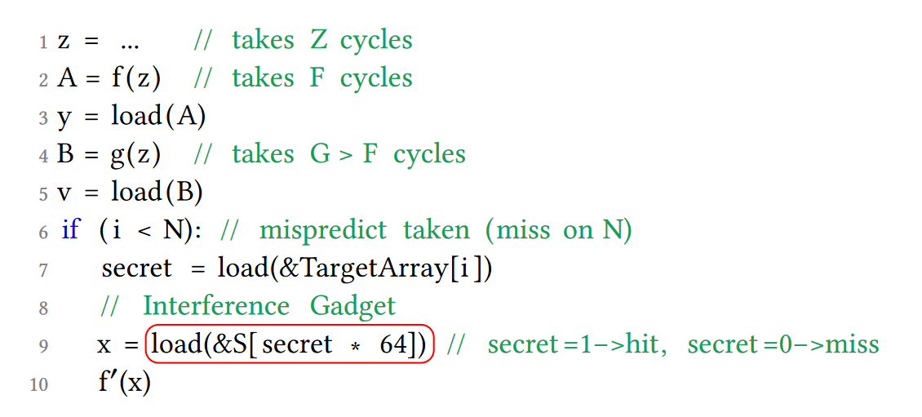
Speculative Interference
contention on a non-pipelined EU. Instruction sequences f and f’ use the same non- pipelined EU. Instruction sequence 𝑔 uses a different EU

